Slide 1

Enterprise Application Security
Litsietsi Montsi

Slide 2
Common Security threats to the modern enterprise
Main the middle attack
Cross site scripting
Cross site request forgery
Denial of service attack
Malicious code, virus and worms
Other, e.g. data packet sniffing

Slide 3
Difference between cross site scripting and cross site request forgery
Fundamental difference is that CSRF (Cross-site Request forgery) happens in authenticated sessions when the server trusts the user/browser, while XSS (Cross-Site scripting) doesn't need an authenticated session and can be exploited when the vulnerable website doesn't do the basics of validating or escaping input.

Slide 4
Introduction
This lecture focuses more on the practical side of Enterprise security and all the implementations that can curb cyber attacks, more specifically, TLS.
What is TLS?
For more on the theoretical side, explore ISO 27000 Series family of information security standards.

Slide 5
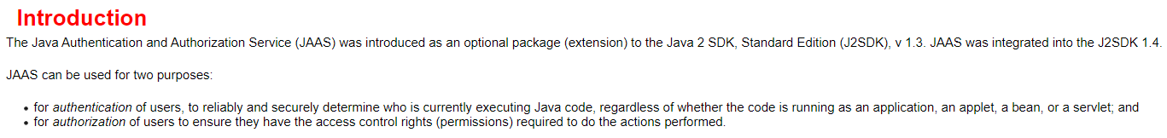
Mitigation of common enterprise security threats
The most common ways to mitigate security threats in the cyber space are:
Authentication
Authorization
Java even implemented JSR 196, a security module called the Java Authentication and Authorization service.

Slide 6
Implementation of Authentication & authorization
Login module
Username and password -> authentication
Profile retrieved with certain roles and permissions -> authorization
Encryption
Data hidden for an authorized access.
TLS
Encryption (asymmetric and symmetric encryption) ->authorization
Authentication (Domain/host identification)
Host trust (certificate signing) -> authentication

Slide 7
TLS Introduction
TLS – Transport Layer Security.
Integral part of the Public Key Infrastructure (PKI)
Proceeds the deprecated SSL (Secure Socket Layer)
Makes use of X.509 certificates to enable https.
Browser use https and have a way of telling whether a site is https enabled.

Slide 8
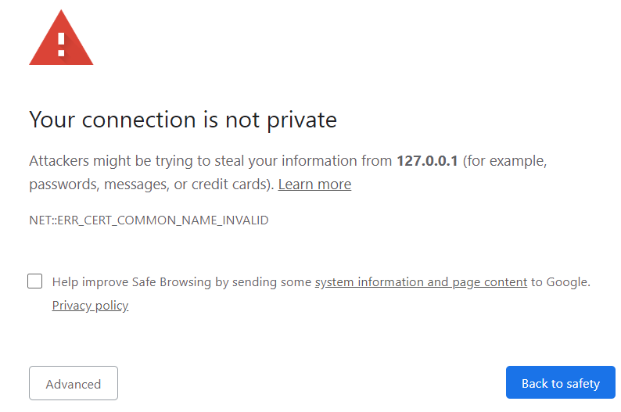
How browser indicate HTTPS use or no HTTPS
Certificate errors

Slide 9
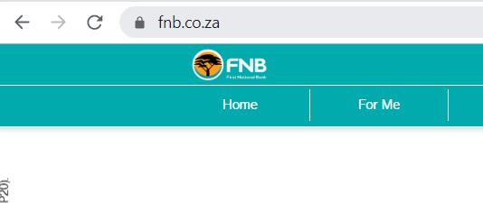
How browser indicate HTTPS use or no HTTPS
Padlock on browser address

Slide 10
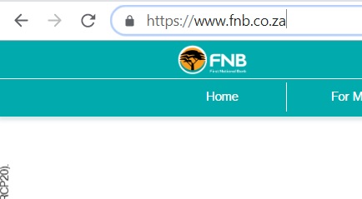
How browser indicate HTTPS use or no HTTPS
Protocol of the URL beginning with https

Slide 11


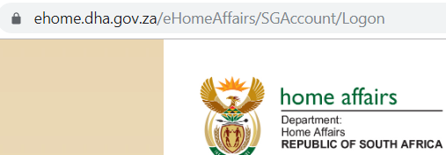
Public Key Infrastructure (PKI)
Security Framework
Users :
Governments
Military
Enterprises
Most user applications:

Slide 12
Public Key Infrastructure (PKI)
An ecosystem that enables trust and encryption of user`s interaction to the general internet using certificates and public key encryption.
The ecosystem described above consists of:
Policies
Software
Hardware
Procedures
Asymmetric Encryption : 2 key encryption. Public and private key.

Slide 13
Public Key Infrastructure (PKI)
Facilitate trust and security when transferring over the internet.
Trust over the internet is achieved through Certificate Authorities.

Slide 14
Public Key Infrastructure (PKI)
Certificate authorities operate on a distributed trust model

Slide 15
Public Key Infrastructure (PKI)
Certificate have a certificate chain of trust.

Slide 16
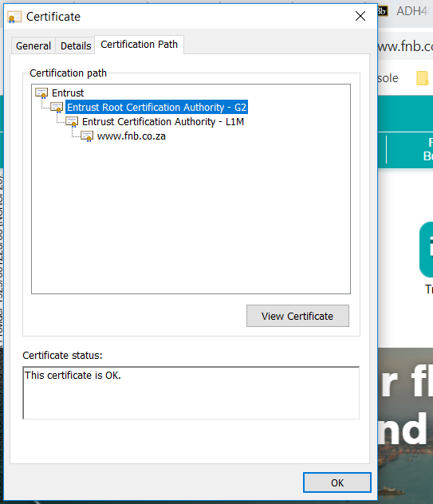
Public Key Infrastructure (PKI)
Example of a certificate chain of trust.

Slide 17

Public Key Infrastructure (PKI)
Certificate authority video

Slide 18
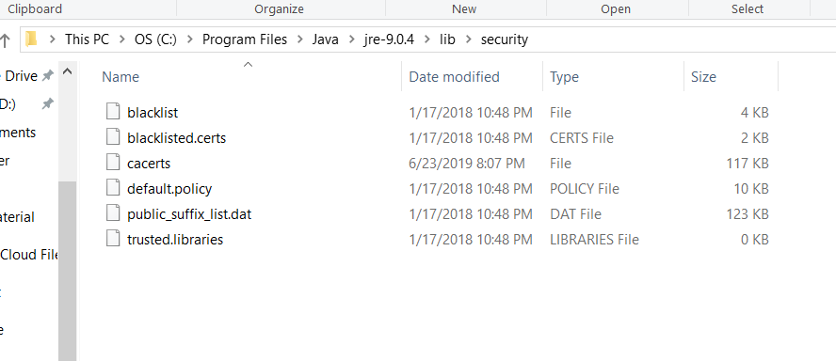
PKI in the context of Java
Trust store is a key store that has root CA certificates to trust end-user certificates issued by those root CA.
In java, the trust store is stored at:
$JAVA_HOME/jre/lib/security/cacerts

Slide 19
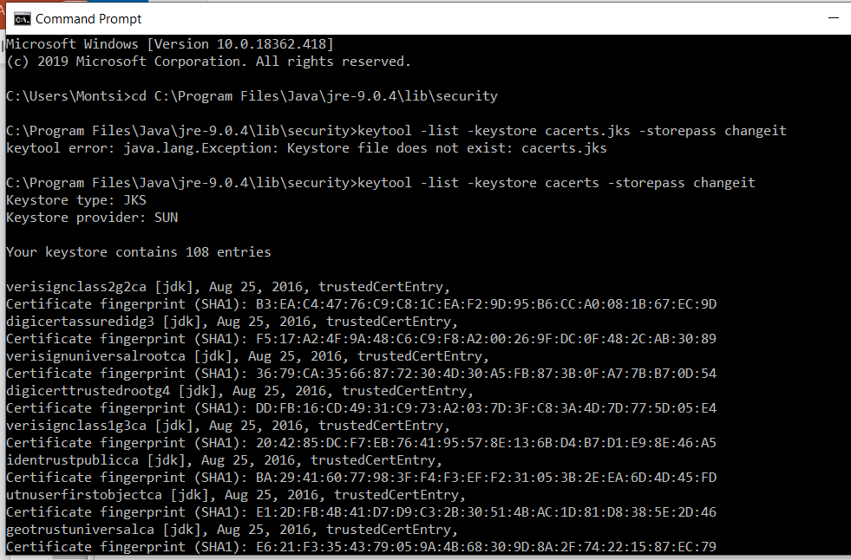
PKI in the context of java
Viewing the java keystore: run the following command
keytool -list -keystore cacerts.jks -storepass changeit

Slide 20
PKI in the context of java
Identity store:
Servers also have identity stores. These are similar to trust stores, but they hold private – public key pair of the server. Usually they hold one key that as the server`s identity.
Execute the command:
keytool -genkey -keyalg RSA -alias serveralias -keystore keystore.jks -storepass password -validity 365 -keysize 2048 -ext san=dns:localhost
Keystore format
JKS = java keystore
PKCS12 = Public-Key Cryptography Standards

Slide 21
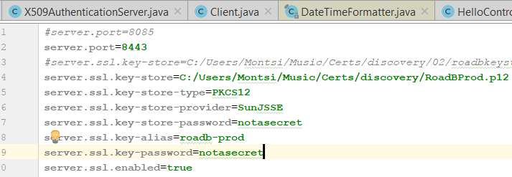
PKI in the context of java
Application server can be configured for PKI (TLS)
Springboot via properties file
Java EE via standalone.xml
Spring boot example: view video of collaborate (mytutor)

Slide 22
TLS Handshake
The TLS handshake is the process that kick starts secured communication session between two or more systems using TLS Encryption. This can be summarized below:

Slide 23
TLS Handshake
Client Hello
The client or browser send the server, the supported cipher suite along with other information.
TLS version supported by client
Cipher suite (Encryption algorithm)
Server hello
The server send the browser the chosen cipher suit and the server`s certificate.
Chosen TLS version
Chosen cipher suite
Server certificate (public key)

Slide 24
TLS Handshake
Authentication
The client authenticates server
Verifies that server certificate is from trust authority that issued it.
Verifies server through verifying domain.
Key Exchange (the symmetric key exchange)
Client uses server key to encrypt the symmetric key.
Client shares the symmetric key with server.
Server decrypts the symmetric key using its private key.
Both server and client/Browser, start using the symmetric key which they both have.

Slide 25
Java Keytool commands
-genkeypair -alias alias -keyalg keyalg -keysize keysize -sigalg sigalg -dname dname -keypass keypass -validity valDays -storetype storetype -keystore keystore -storepass storepass -providerClass provider_class_name -providerArg provider_arg -v -protected -Jjavaoption
General command for key pair generation

Slide 26
Java Keytool commands
"C:\\Program Files\Java\jdk1.8.0_111\bin\keytool" -genkeypair -alias digibankKey -keyalg RSA -keysize 2048 -dname "CN=Jakob Digibank, OU=Digibank Aps, O=Digibank Aps, L=Copenhagen, ST=Unknown, C=DK" -keypass 93f8d81c43440aaf1ed33424b1174ed4 -validity 100 -storetype JKS -keystore keystore.jks -storepass notasecret
Generating a Key pair

Slide 27
Java Keytool commands
-exportcert -alias alias -file cert_file -storetype storetype -keystore keystore -storepass storepass -providerName provider_name -providerClass provider_class_name -providerArg provider_arg -rfc -v -protected -Jjavaoption
General commands to export a certificate

Slide 28
Java Keytool commands
"C:\\Program Files\Java\jdk1.8.0_111\bin\keytool" -exportcert -alias digibankkey -keypass 93f8d81c43440aaf1ed33424b1174ed4 -storetype JKS -keystore keystore.jks -file cert.cert -rfc -storepass notasecret
Exporting a certificate

Slide 29
Java Keytool commands
-importcert -alias alias -file cert_file -keypass keypass -noprompt -trustcacerts -storetype storetype -keystore keystore -storepass storepass -providerName provider_name -providerClass provider_class_name -providerArg provider_arg -v -protected -Jjavaoption
General command to import a certificate

Slide 30
Java Keytool commands
"C:\\Program Files\Java\jdk1.8.0_111\bin\keytool" -importcert -alias digibankkey -keypass 93f8d81c43440aaf1ed33424b1174ed4 -storetype JKS -keystore keystore2.jks -file cert.cert -rfc -storepass notasecret
Importing a certificate

Slide 31
Java Keytool commands
-list -alias alias -storetype storetype -keystore keystore -storepass storepass -providerName provider_name -providerClass provider_class_name -providerArg provider_arg -v -rfc -protected -Jjavaoption
General Command to List Keys

Slide 32
Java Keytool commands
"C:\\Program Files\Java\jdk1.8.0_111\bin\keytool" -list -storetype JKS -keystore keystore.jks -storepass 93f8d81c43440aaf1ed33424b1174ed4
Listing Keys

Slide 33
Java Keytool commands
-delete -alias alias -storetype storetype -keystore keystore -storepass storepass -providerName provider_name -providerClass provider_class_name -providerArg provider_arg -v -protected -Jjavaoption
General Command to Delete a keystore entry

Slide 34
Java Keytool commands
"C:\\Program Files\Java\jdk1.8.0_111\bin\keytool" -delete -alias digikey -storetype JKS -keystore keystore.jks -storepass notasecret
Deleting a keystore entry

Slide 35
Java Keytool commands
-certreq -alias alias -sigalg sigalg -file certreq_file -keypass keypass -storetype storetype -keystore keystore -storepass storepass -providerName provider_name -providerClass provider_class_name -providerArg provider_arg -v -protected -Jjavaoption
General Command to generate a certificate request

Slide 36
Java Keytool commands
"C:\\Program Files\Java\jdk1.8.0_111\bin\keytool" -certreq -alias digibankkey -keypass 93f8d81c43440aaf1ed33424b1174ed4 -storetype JKS -keystore keystore.jks -storepass notasecret -file certreq.certreq
Generating a certificate request

Slide 37
Assignment (no submission)
Generate a certificate an organization named “adh401”.
With domain www.adh401.co.za.
Using the same address as the TUT soshanguve campus.
This will need to be self signed.
Configure Wildfly to work with your certificate using a dummy, one-page web based/ear project.
Hint : the configuration is in standalone.xml
Do not submit this assignment, it is for your own benefit.

